Slide 1

V2V
Starbucks
MCG
Notes:
A barista touches the life of individuals every day
This happens a thousand times throughout the world
This means that Starbucks is planting roots in every community
And understands the vision of a shared planet
With that vision in mind, partners have the opportunity to go beyond the role of barista
With V2V partners have the opportunity to select the ways in which they want to engage the community
They can tell customers to get on the site and find them
They can join projects in their local area

Slide 2
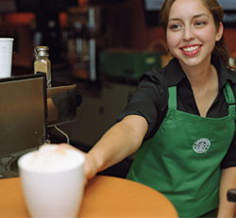
Connections…
Everyday a barista touches the life of someone.

Slide 3



…around the world…
Which means Starbucks is rooted deep in the community.
Thousands of these connections happen every day.

Slide 4


…that builds community…
And truly understands the vision of a shared planet.
Now there is an option, a way to engage even deeper.

Slide 5
…and provides a choice…

Slide 6
…for the future…
You have the power to grow where there is the most light

Slide 7
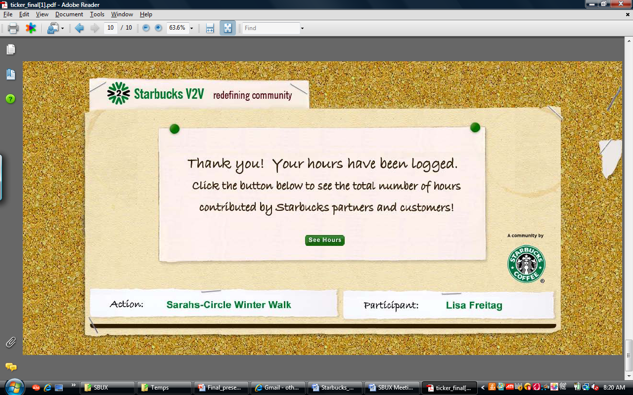
…it all starts with a goal…
1,000,0000
Community
Network
Goal:
1,000,000 Hours
By 2015
Virtual Stores
500,0000
Actions
People
0
Commitment

Slide 8
…commitment…
INSPIRE people
to contribute to a cause
greater than themselves.
One partner, one voice, one cup at a time.

Slide 9
…people…
V2V Network
Starbucks
Community
Social Entrepreneurs
Partners
Customers
Connecting with your customers in a new way.

Slide 10
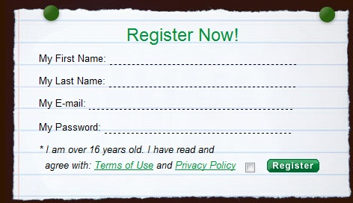
…action…
Provide Virtual Environment

Slide 11
…virtual stores…
Post
Network
Read
Share
Act
Post community events to the store page.

Slide 12
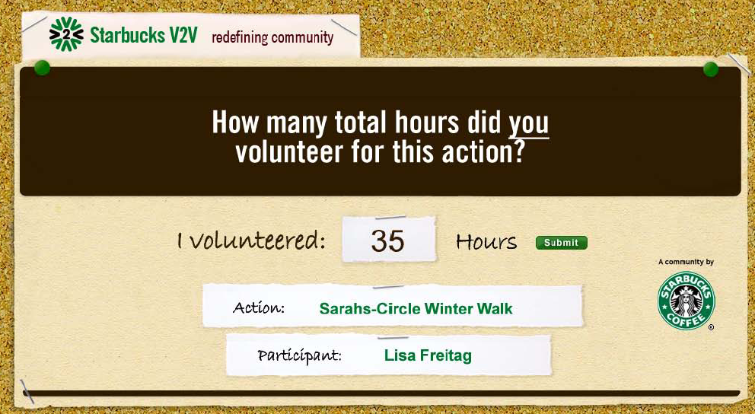
…network…
Global Hour Tracking System

Slide 13
…community…
Re-engage partners.
Re-ignite bond with customers.
Make stores the heart of our local neighborhood.
Redefining Community

Slide 14
…V2V…
1,000,0000
JOIN….
500,0000
PLEDGE….
REDEFINE….
0
One Million is a big number.

